Slide 1
Analysis of daily expenses
We’ll analyse the daily expend money by myself from past three years and make conclude whether its normal expenses or over expenses.

Slide 2
Introduction of data
This Data is taken or created by myself, on the basis of my daily expenses.
I have collected this data from past three years.
I referred my bank statement to create this dataset.

Slide 3
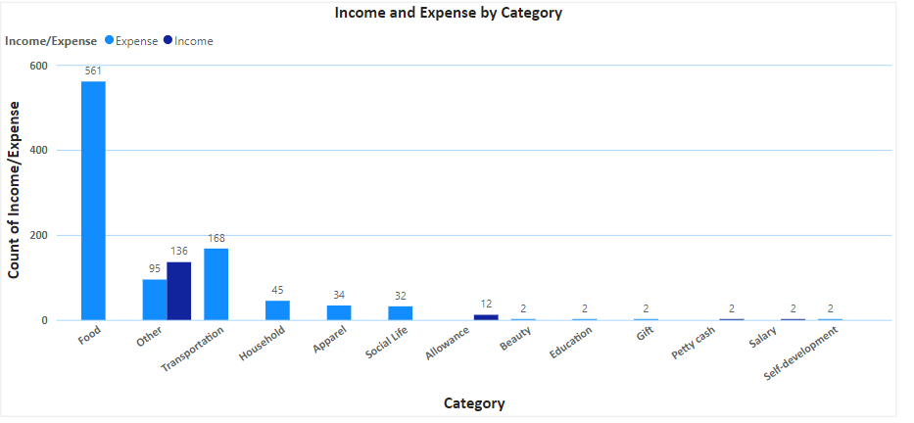
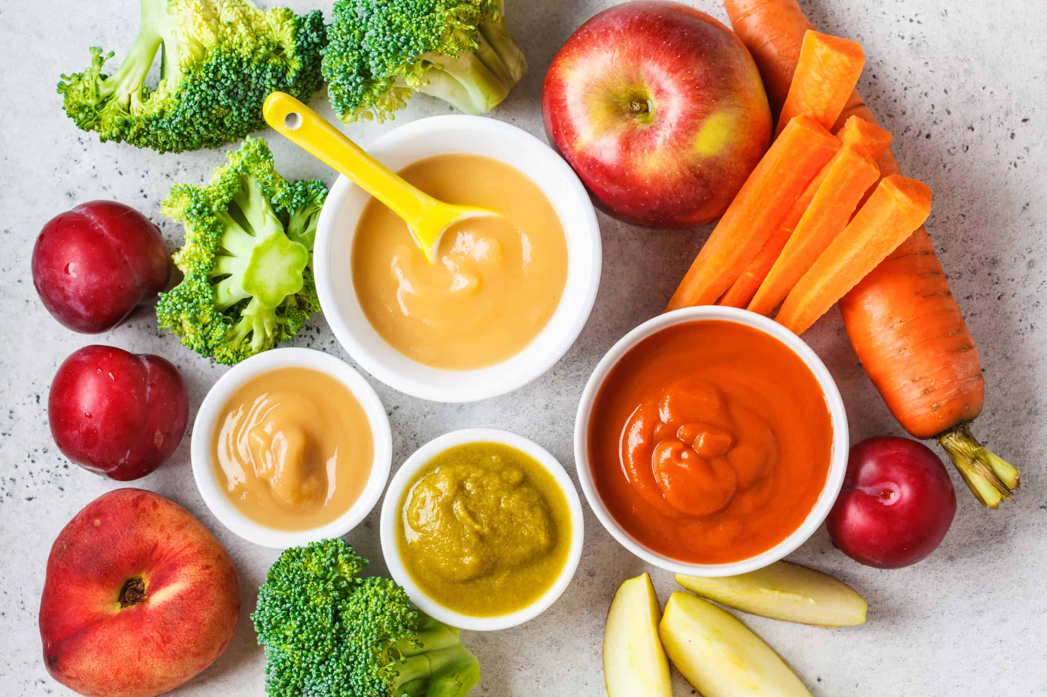
As you can see the visuals its clearly indicates that I have spend lots of money on the food.
Food plays very important role in human life.

Slide 4
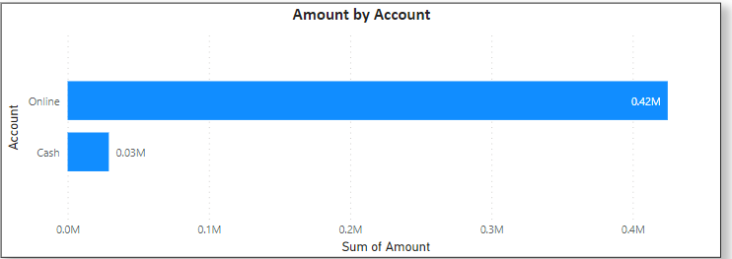
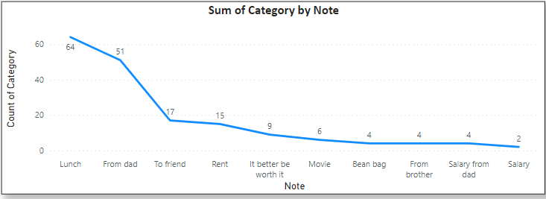
In this visuals you can say that I don’t carry to much cash for daily expenses.
I preferred online transaction most of the time, because its easy and reliable source of payment.
Its also allow us to feel free from weight of the cash.
As you previously see that I have spend lots of money on food, here are some visuals which give idea on which food I spend money.
I.e. Lunch.

Slide 5
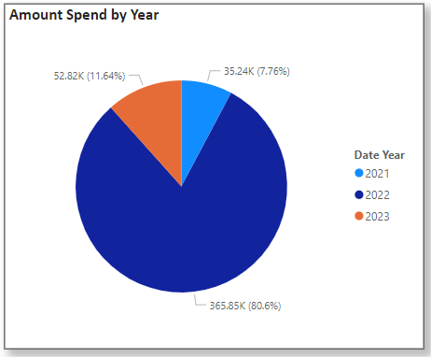
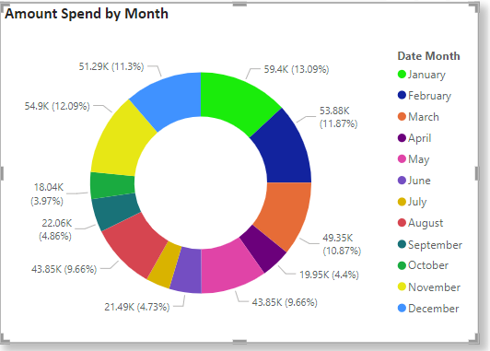
Here are some visuals for yearly expenses, and its clearly indicates that I have spend more in year 2022.
This output come because I have taken most of the data from year 2022 itself.
In this visuals of expenses, and its clearly indicates that I have spend more in Month of January.
And November is the second highest month in the terms of expenses.

Slide 6
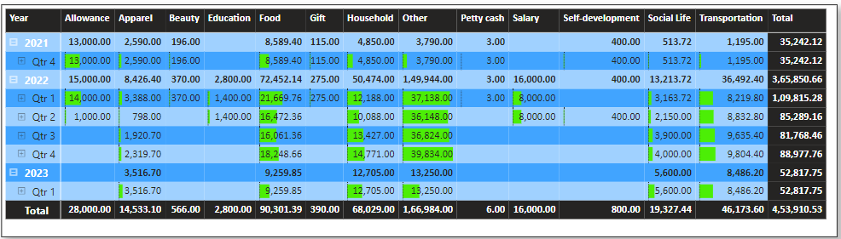
This is the quarter wise spend data for all three years.
Its also shows the total money I have spend in the spam of three years.

Slide 7
Conclusion
From all this visual I have made some conclusion over my expenses.
I have spend more money in years 2022.
January was the highest month in the term of expenses, followed by November.
I have mostly spend my money on food, specially lunch.
Most of the time I have used online payment mode for transaction.
I have spend 4,53,910 INR in this three years, which is over expenses.

